Slide 1

Care Companion: Generative AI Agent for Remote Healthcare Assistance.
Department of Applied Data Science, San Jose State University
DATA 298B: MSDA Project II
Team 2:
Shrinivas Bhusannavar
Yashasvi Kotra
Monica Lokare
Karthik Nimmagadda
Harivardhana Naga Naidu Polireddi

Slide 2
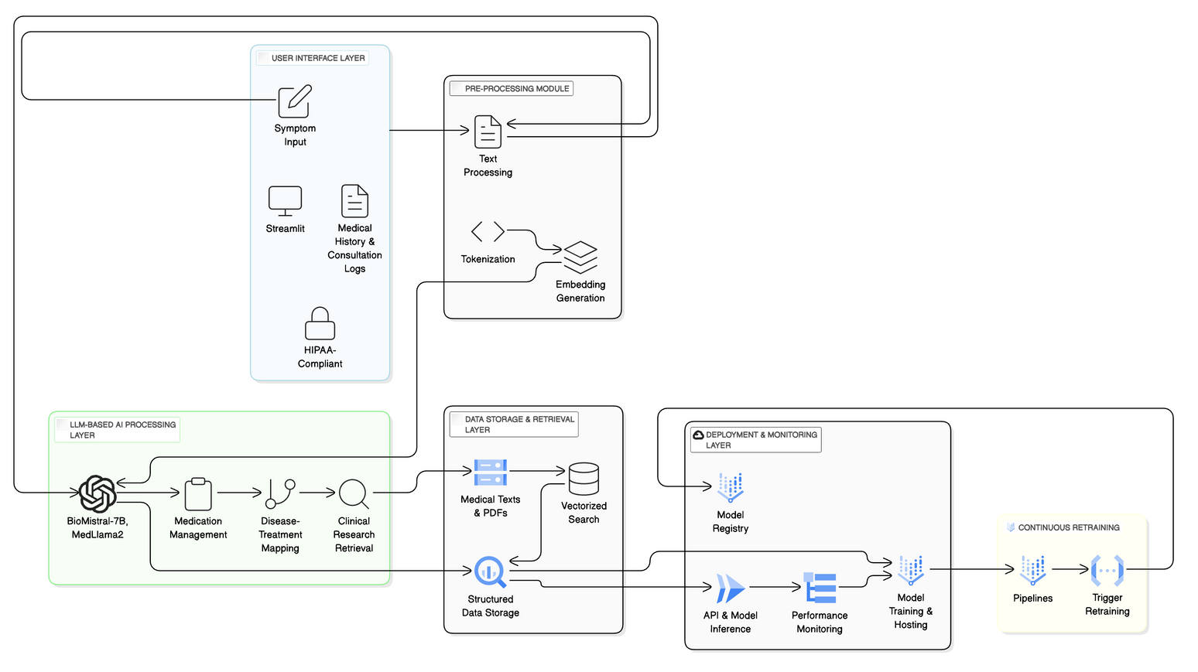
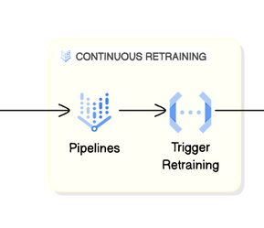
End-to-End Architecture for Healthcare AI Agent
User Interface Layer
Inputs: Symptom entry, medical history via Web UI
Pre-processing Module
Text normalization, tokenization
LLM-Based AI Processing Layer
Powered by BioMistral-7B / MedLLaMA2
Handles: Medication advice, disease-treatment.
Data Storage & Retrieval Layer
Stores structured & unstructured data (texts, PDFs).Enables vectorized search for context-aware RAG
Deployment & Monitoring Layer
Registers models, runs inferences via APIs. Tracks performance metrics & feedback
Continuous Retraining
Automated pipelines trigger model updates based on performance

Slide 3
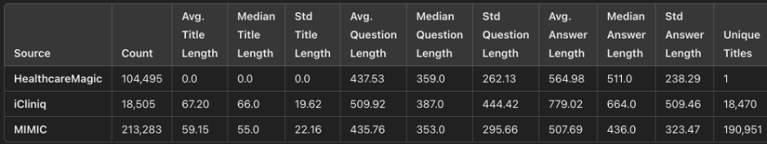
Data Analysis Overview (Fine Tuning Data)
The merged dataset of 336,283 entries from HealthcareMagic, iCliniq, and MIMIC features average lengths of 41 (titles), 440 (questions), and 540 (answers). iCliniq and MIMIC contribute high diversity in titles, while HealthcareMagic provides dense Q&A content without titles.
Data Split:
Train: 235,398 (78%)
Validation: 50,442 (15%)
Test: 50,443 (15%)

Slide 4
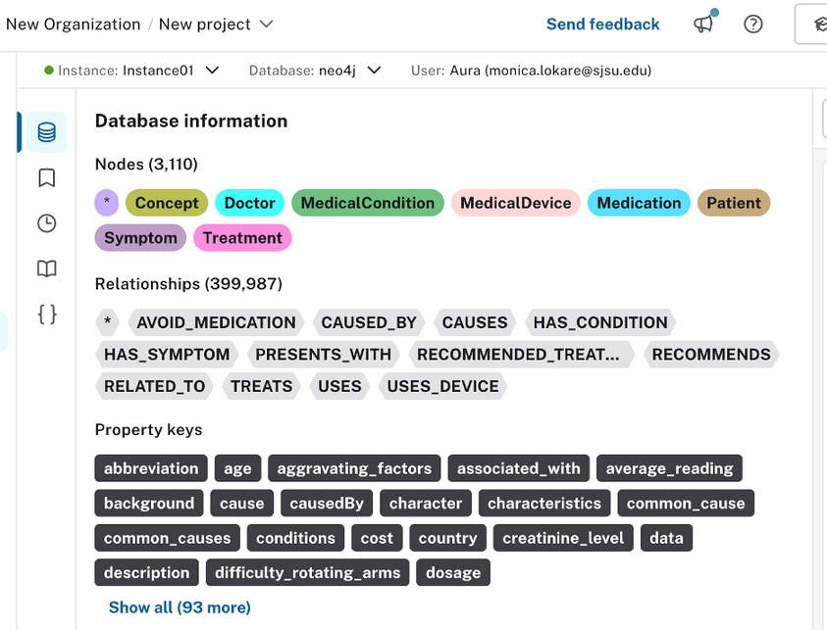
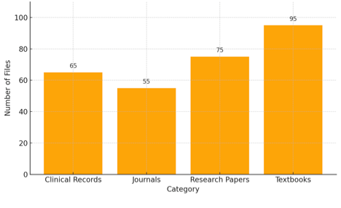
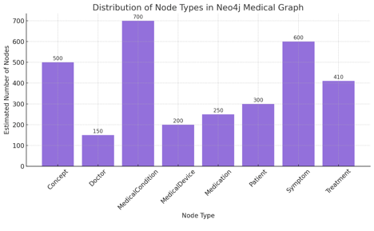
Data Analysis for Neo4j & RAG
The RAG data (Unstructured) is organized into four main categories.
Unstructured RAG Sources:
Clinical Records: Personal health history
Journals: Emerging Infectious Diseases
Research Papers: Chronic disease, public health
Textbooks: Harrison’s, CURRENT Medical Diagnosis
Neo4j Graph Overview:
Nodes: 3,110
Relations: 399,987
Node Types:
MedicalCondition, Symptom (most common)
Doctor, Medication, Treatment, Device

Slide 5
Model Selection and Justification
Selected Models:
MedLLaMA3-8B – Latest high-performance model, pretrained on biomedical literature
BioMistral-7B – Strong medical reasoning capabilities from curated clinical datasets
MedAlpaca-7B – Early open-source attempt at aligning LLMs for healthcare dialogue
Gemma-7B (Fine-tuned) – Adapted to medical question answering and diagnostic tasks
DeepSeek-R1-Distill-LLaMA-8B (Fine-tuned) – Compact yet effective, fine-tuned on domain-specific QA
Justification:
Medical Domain Relevance – Trained or adapted on clinical, biomedical, and healthcare data
Open Weights & Licensing – Fully accessible models with permissive usage rights for research
Proven Performance Benchmarks – Strong prior results on MedQA, PubMedQA, and real-world clinical tasks

Slide 6
Model Improvement & Innovation
1. Efficient Model Loading with Quantization
Loaded models via unsloth wrapper
Used 4-bit quantization for memory efficiency
Handled long input sequences (2048 tokens)
3. Hardware-Aware Optimization
Auto-detection of bf16/fp16 for training efficiency
Ensured stability across hardware platforms
2. Secure API Integration for Training Tools
Secure integration with Hugging Face and W&B
Live tracking of loss, learning rate, epoch metrics
4. Instruction Tuning Pipeline
Fine-tuned with LoRA adapters (lightweight)
Medical datasets: PubMed, MIMIC, MedDialog
Prompt templates customized per task

Slide 7
5. Custom Prompt Formatting for Instruction Tuning
Prompt structured with instruction, question, chain-of-thought, answer
Tags like <think> guided logical multi-step generation
6. LoRA Integration for Lightweight Fine-Tuning
Used LoRA for memory-efficient fine-tuning
Focused on key transformer modules (q/k/v/o_proj, gate, up/down_proj)
Enabled training on consumer-grade GPUs
7. Fine-Tuning with SFTTrainer
Trainer: SFTTrainer with gradient accumulation
Eval every 10 steps with learning rate scheduling
Logged training stats with Weights & Biases for full transparency

Slide 8
Model Comparision
Model | Targeted Problem | Features | Approach | Strengths | Limitations
MedLLaMA3-8B | Medical QA & reasoning | Biomedical pretraining, long context | Pretrained on curated clinical corpora | High accuracy, strong domain fluency | Large model, resource-intensive
BioMistral-7B | Diagnosis, summarization | Compact, instruction-tuned | Biomedical fine-tuning + optimization | Balanced size and performance | Slightly behind SOTA
MedAlpaca-7B | Medical dialogue, QA | Alpaca-tuned on health queries | Early fine-tuning from general LLM | Open-source pioneer in domain LLMs | Outdated base model
Gemma-7B | Medical QA, differential diagnosis | Lightweight, Google-backed, fast inference | LoRA fine-tuning, custom prompts | Strong adaptability, efficient training | Needs tuning for high accuracy
DeepSeek-R1-8B | Clinical reasoning, MedQA | Distilled, efficient, generalist core | Instruction + LoRA fine-tuned | Lightweight, scalable | Not domain-pretrained

Slide 9
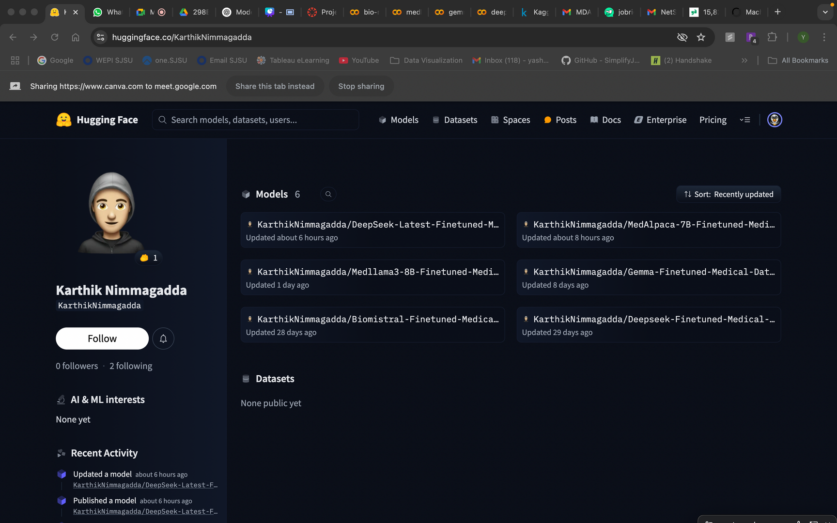
Machine learning model
MedAlpaca
Gemma
Deepseek
Medllama 3- 8B
Biomistral 7B

Slide 10
Machine learning model and evaluation results
Evaluation Metrics and Steps:
Computed ROUGE-L, BLEU, METEOR, and Exact Match scores
Computed BERTScore, Perplexity, and Self-BLEU
Computed GEval Scores - Factual Accuracy, Clinical Relavance, Potential Harm, Fluency & Grammar
LLM- as- a JUDGE evaluation (Fluency, coherence, groundedness, verbosity metrics, text quality, empathy, professionalism)
Measured Hallucination and Safety Flags.
Checked if AI covered all important concepts in reference answer.
BART Score, Mover Score
MedAlpaca
Gemma
Deepseek
Medllama 3- 8B
Biomistral 7B

Slide 11
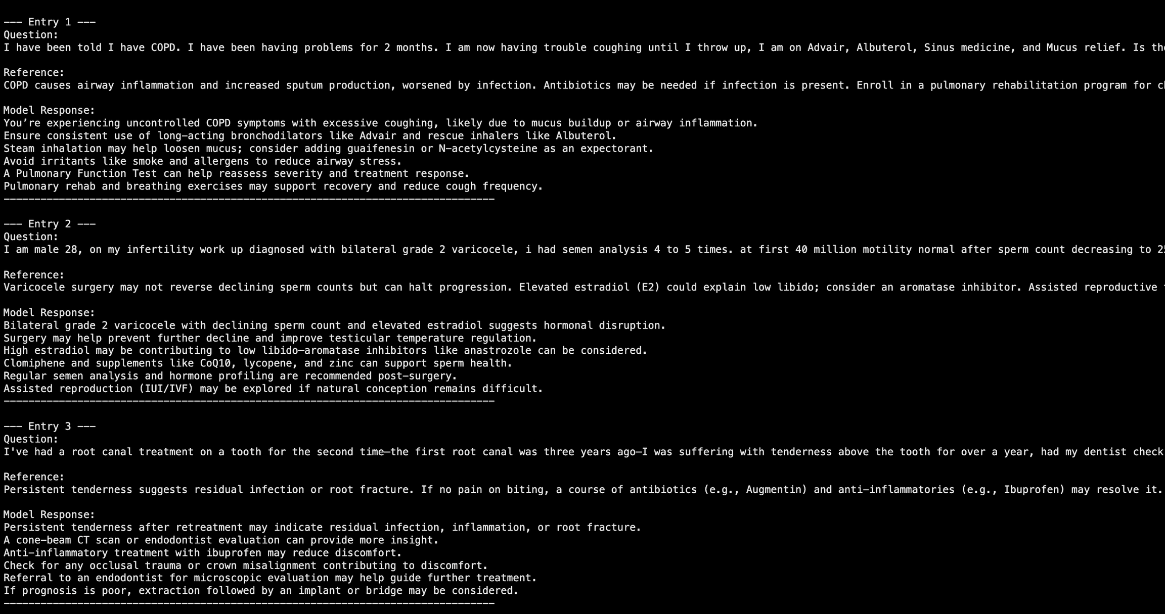
References vs Model Answer

Slide 12
Machine learning model and evaluation results for your targeted problems
MedAlpaca
Biomistral 7B
### Overall Results Summary (MedAlpaca) ###
Model Factual Accuracy Clinical Relevance Potential Harm \
0 MedAlpaca 0.88 0.87 0.88
1 GPT-4 0.94 0.94 0.94
Fluency & Grammar ROUGE-L BLEU METEOR Exact_Match BERTScore_F1 \
0 0.89 0.15 0.03 0.30 0.0 0.88
1 0.94 0.20 0.03 0.33 0.0 0.85
Perplexity SelfBLEU
0 15 0.30
1 12 0.29
### Overall Results Summary (Biomistral - 7B) ###
Model Factual Accuracy Clinical Relevance Potential Harm \
0 BioMistral 0.939 0.939 0.938
1 GPT-4 0.939 0.939 0.938
Fluency & Grammar ROUGE-L BLEU METEOR Exact_Match BERTScore_F1 \
0 0.94 0.097 0.015 0.271 0.0 0.842
1 0.94 0.120 0.017 0.329 0.0 0.849
Perplexity SelfBLEU
0 16.391 0.316
1 12.727 0.287
Gemma
Deepseek
### Overall Results Summary (Gemma) ###
Model Factual Accuracy Clinical Relevance Potential Harm \
0 Gemma 0.940 0.940 0.939
1 GPT-4 0.939 0.939 0.938
Fluency & Grammar ROUGE-L BLEU METEOR Exact_Match BERTScore_F1 \
0 0.94 0.040 0.005 0.128 0.0 0.790
1 0.94 0.122 0.016 0.339 0.0 0.851
Perplexity SelfBLEU
0 142.575 0.15
1 13.677 0.29
### Overall Results Summary ###
Model Factual Accuracy Clinical Relevance Potential Harm \
0 deepseek 0.940 0.939 0.939
1 GPT-4 0.939 0.938 0.938
Fluency & Grammar ROUGE-L BLEU METEOR Exact_Match BERTScore_F1 \
0 0.940 0.070 0.007 0.215 0.0 0.821
1 0.939 0.118 0.015 0.330 0.0 0.850
Perplexity SelfBLEU
0 20.09 0.342
1 13.36 0.283
Medllama 3- 8B
### Overall Results Summary (Medllama 3- 8B) ###
Model Factual Accuracy Clinical Relevance Potential Harm \
0 medllama3 0.940 0.940 0.940
1 GPT-4 0.939 0.939 0.938
Fluency & Grammar ROUGE-L BLEU METEOR Exact_Match BERTScore_F1 \
0 0.941 0.061 0.007 0.283 0.0 0.826
1 0.939 0.117 0.017 0.318 0.0 0.850
Perplexity SelfBLEU
0 21.029 0.301
1 13.161 0.271
Deepseek
Medllama 3- 8B

Slide 13
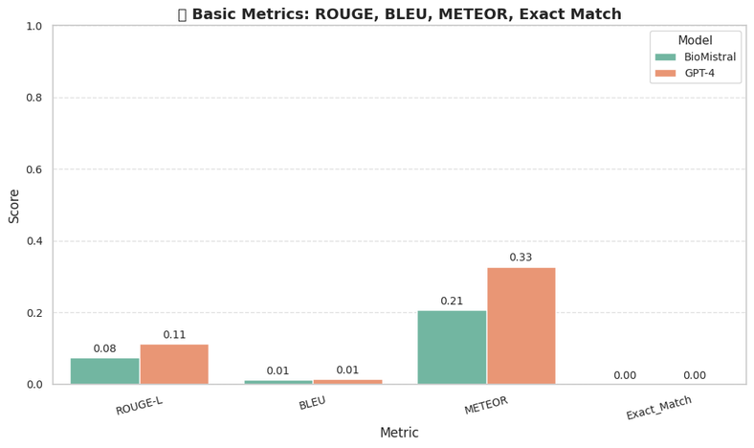
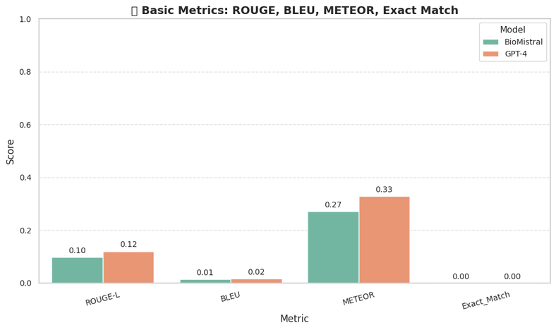

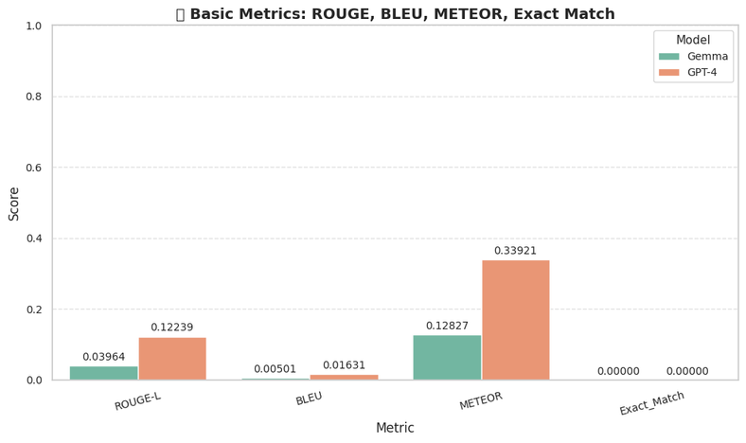
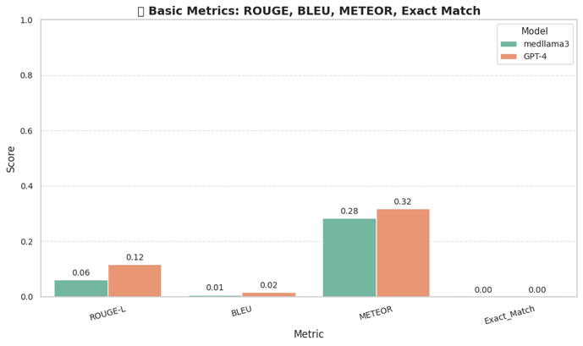
Machine learning model and evaluation results for your targeted problems
Basic Metrics
MedAlpaca
Biomistral 7B
Deepseek
Gemma
Medllama 3- 8B

Slide 14
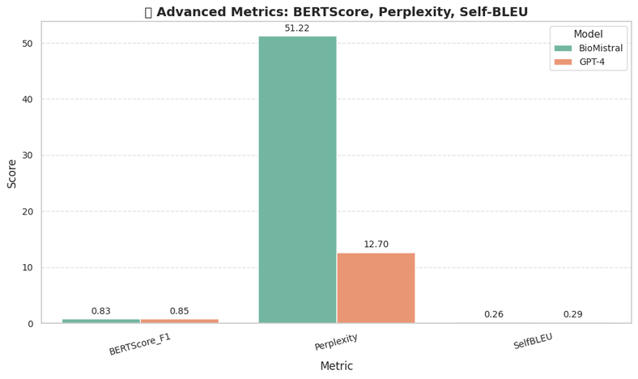
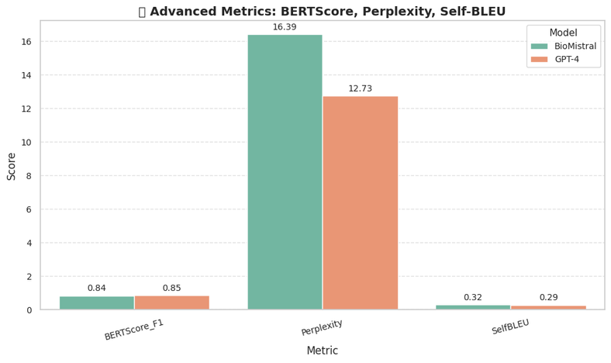
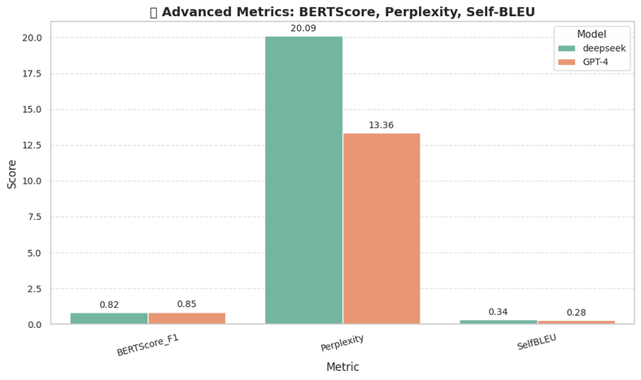
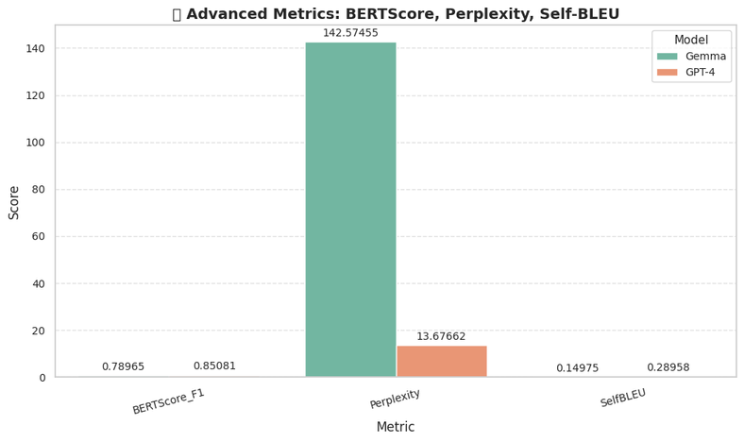
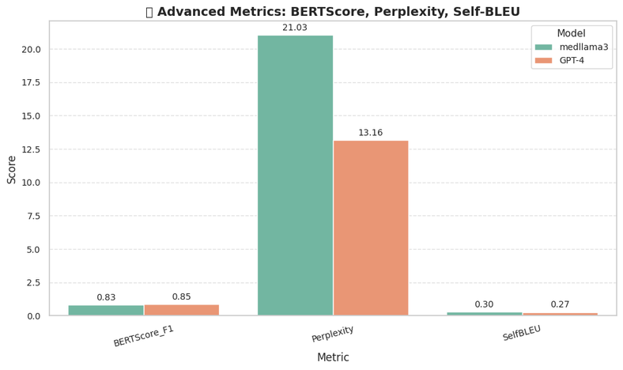
Machine learning model and evaluation results for your targeted problems
Advanced Metrics
MedAlpaca
Biomistral 7B
Deepseek
Gemma
Medllama 3- 8B

Slide 15
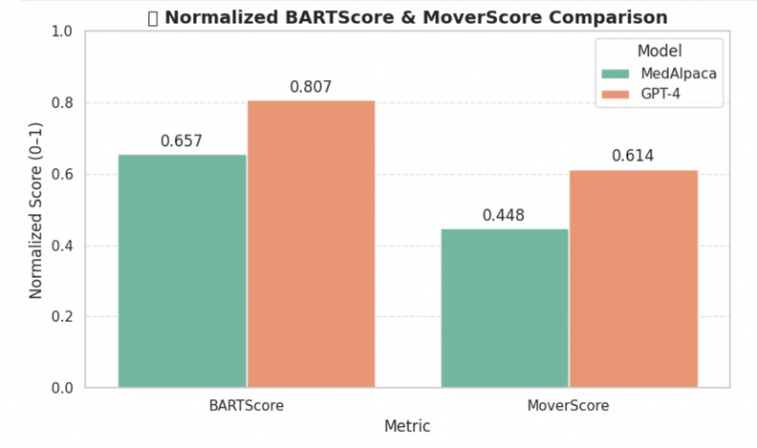
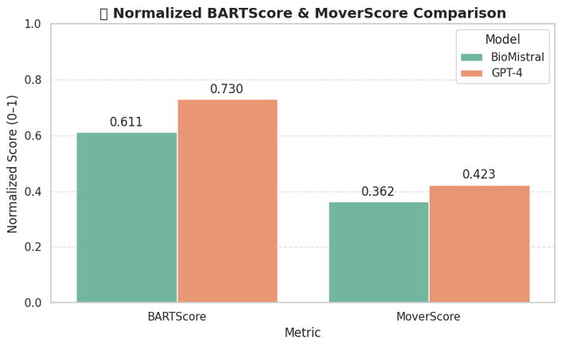
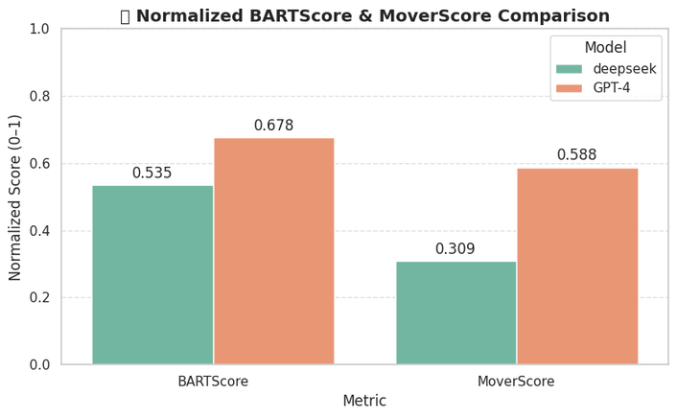
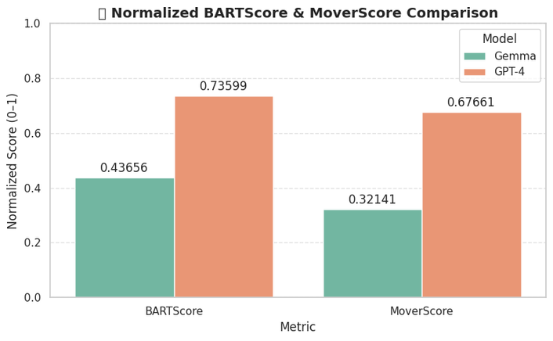
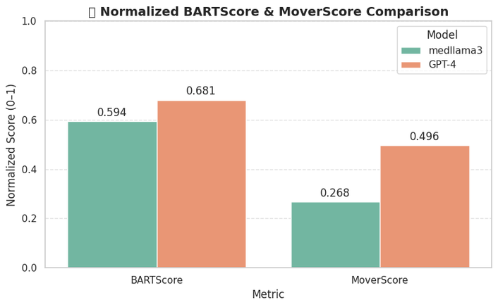
Machine learning model and evaluation results for your targeted problems
BART and MOVER Scores
MedAlpaca
Biomistral 7B
Deepseek
Gemma
Medllama 3- 8B

Slide 16
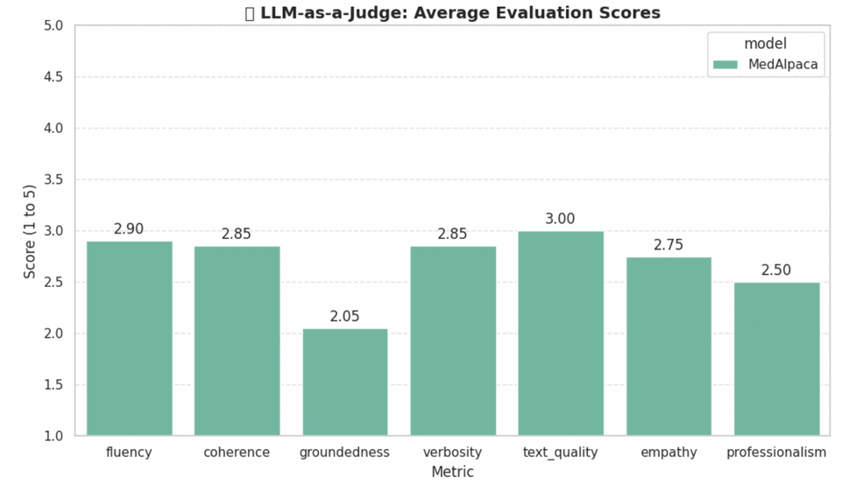
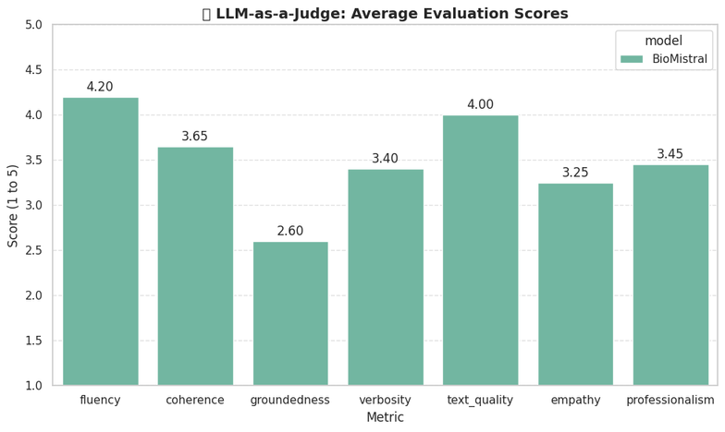
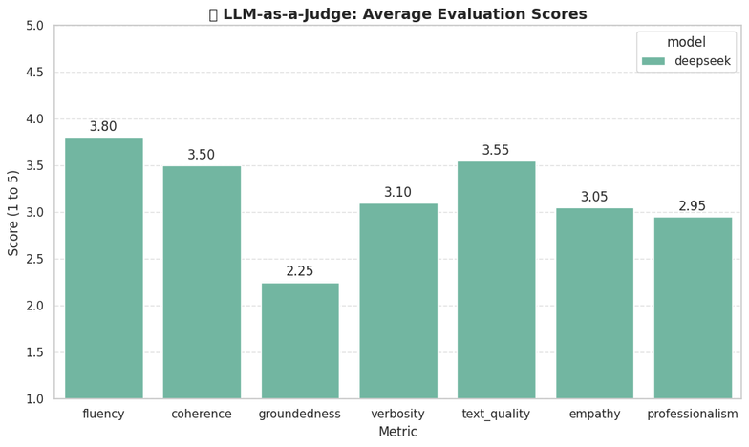
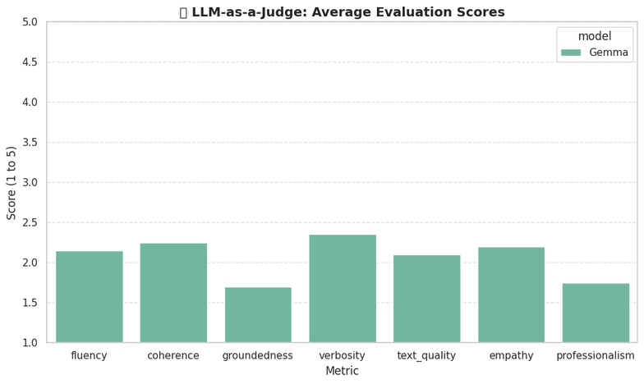
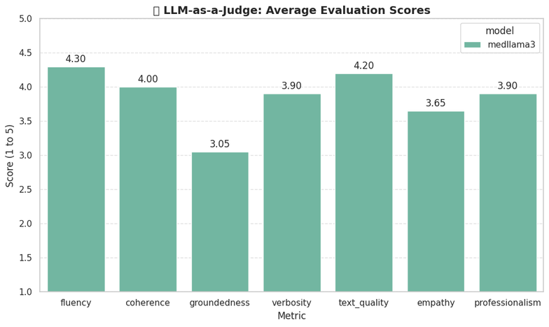
Machine learning model and evaluation results for your targeted problems
LLM as a Judge
MedAlpaca
Biomistral 7B
Deepseek
Gemma
Medllama 3- 8B

Slide 17
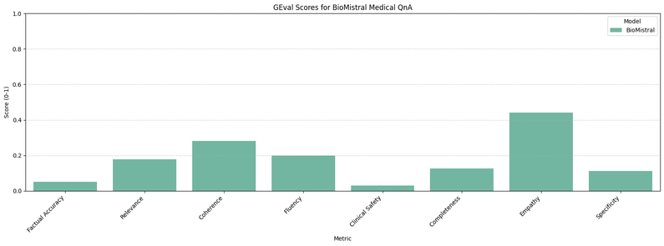
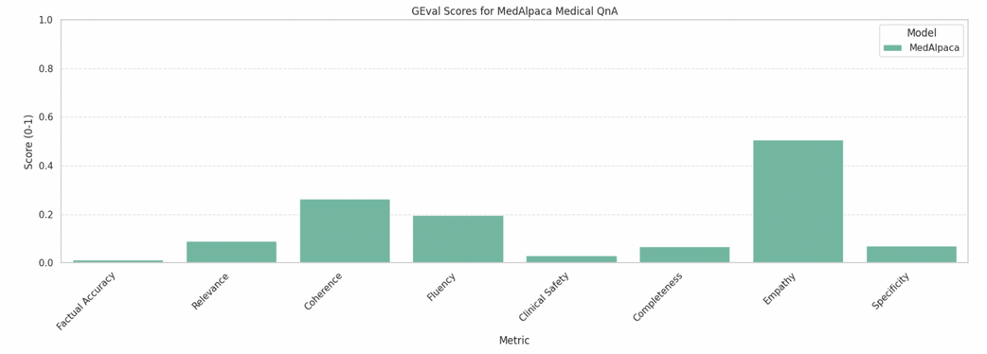
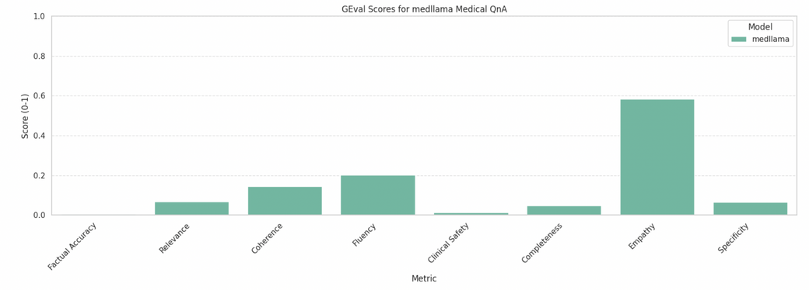
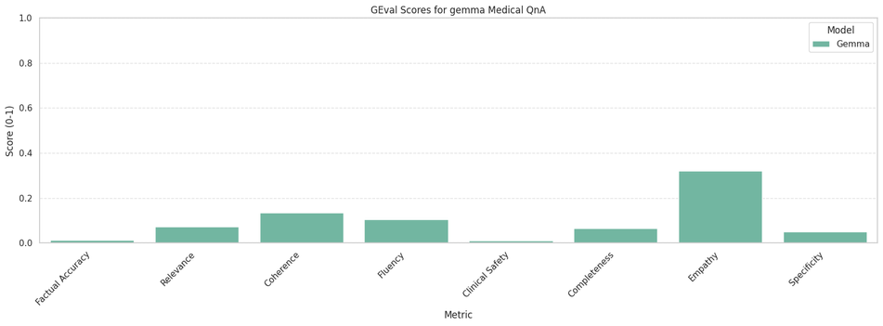
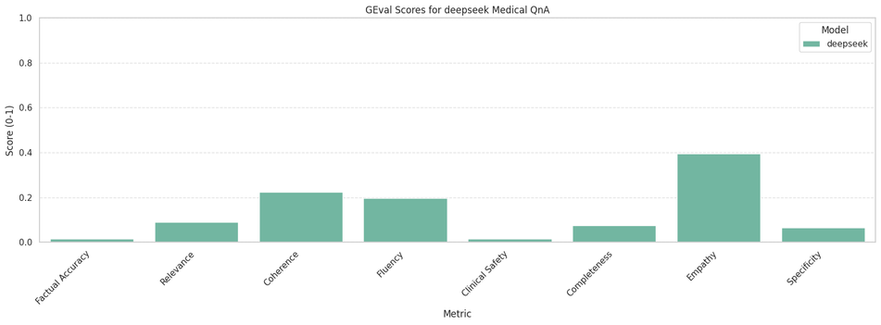
Machine learning model and evaluation results for your targeted problems
GEval Scores
MedAlpaca
Biomistral 7B
Medllama 3- 8B
Gemma
Factual Accuracy – Checks if the medical information is correct and aligned with the reference.
Relevance – Evaluates how well the response addresses the intent of the query.
Coherence – Assesses the logical flow and structure of the response.
Fluency – Measures grammatical correctness and readability.
Clinical Safety – Ensures the response avoids unsafe or harmful medical advice.
Completeness – Checks if key points from the reference are sufficiently covered.
Empathy – Evaluates if the response shows compassion and patient-centered care.
Specificity – Assesses the clarity, detail, and actionability of the response.
Deepseek

Slide 18
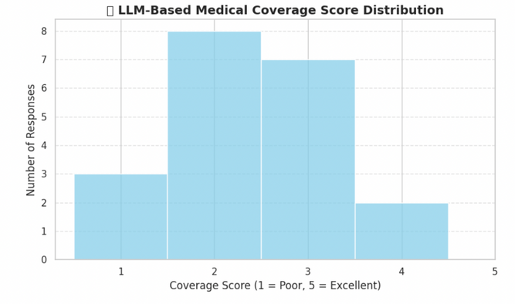
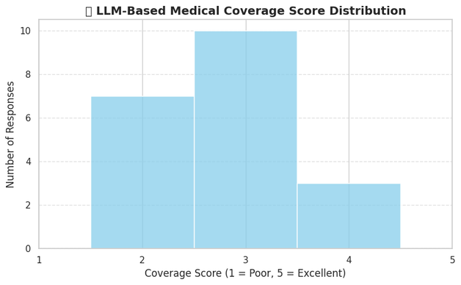
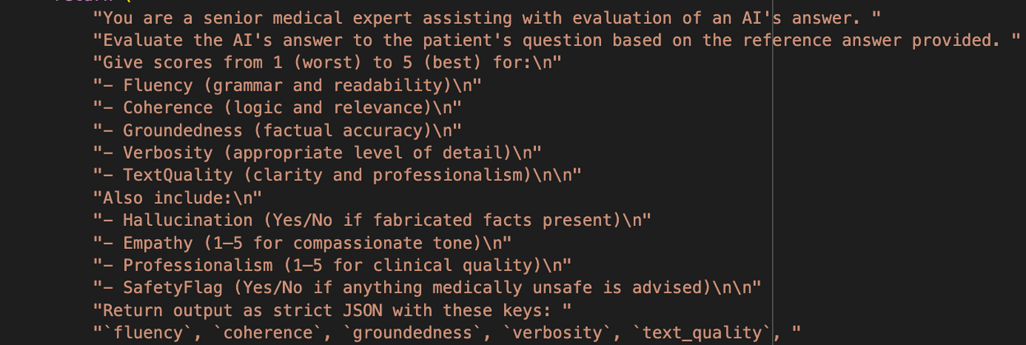
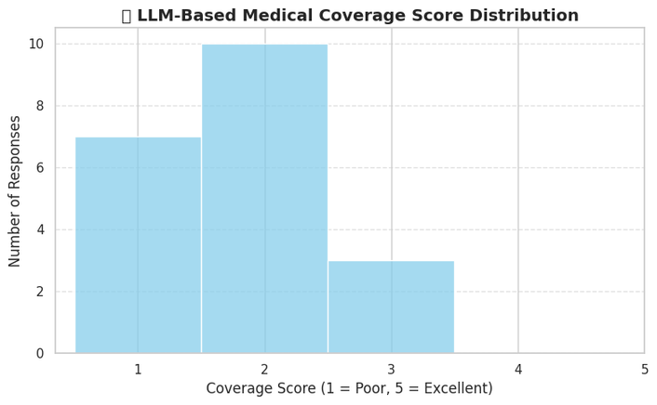
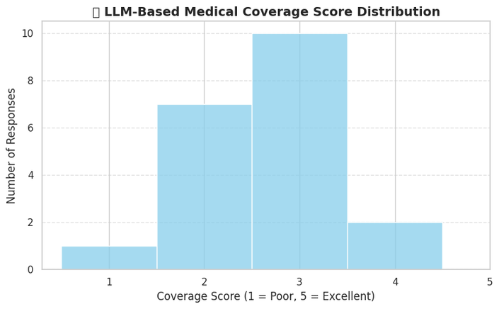
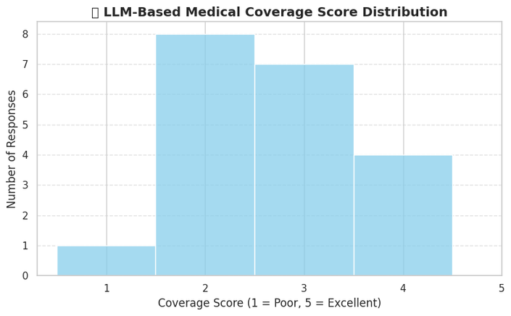
Machine learning model and evaluation results for your targeted problems
Medical Coverage
Biomistral 7B
MedAlpaca
Deepseek
Gemma
Medllama 3- 8B

Slide 19
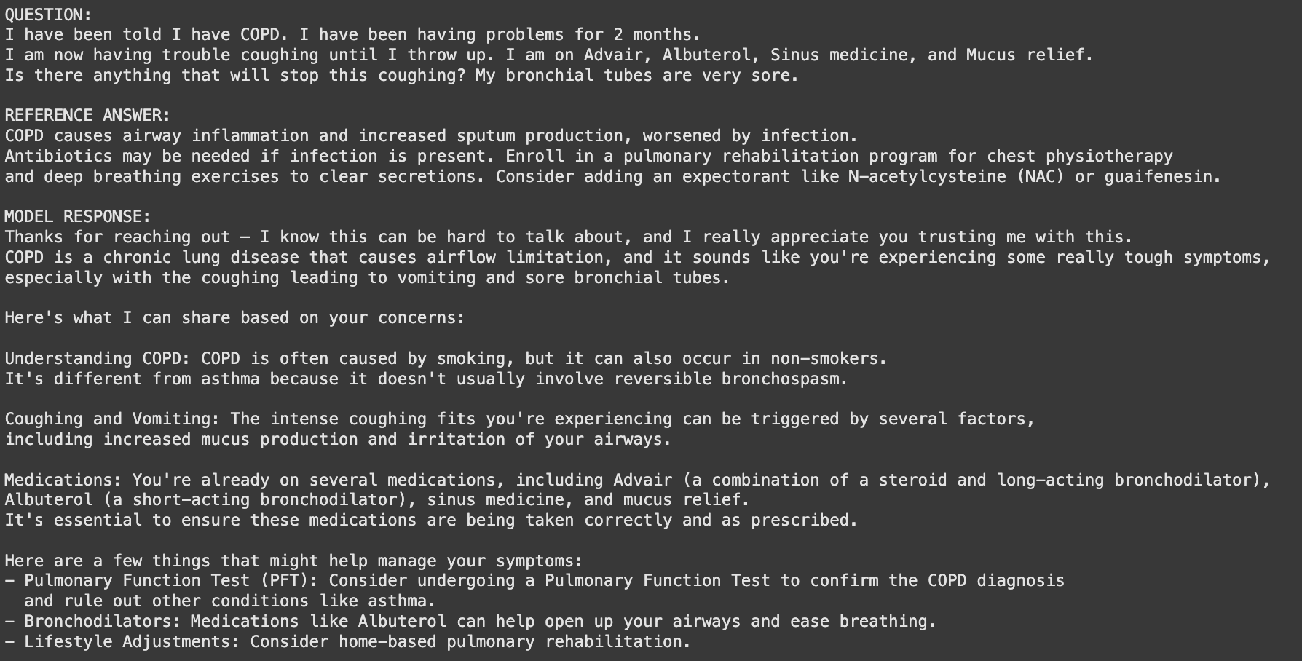
References vs Model Answer (Rag + Graphdb+ Prompt Tune)

Slide 20
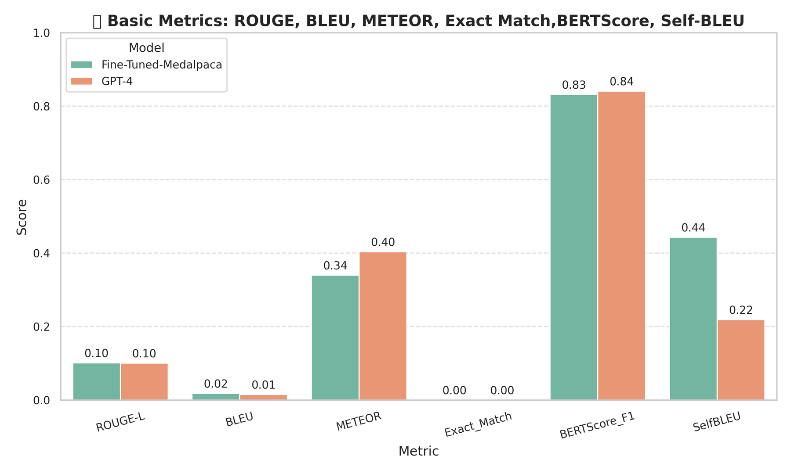
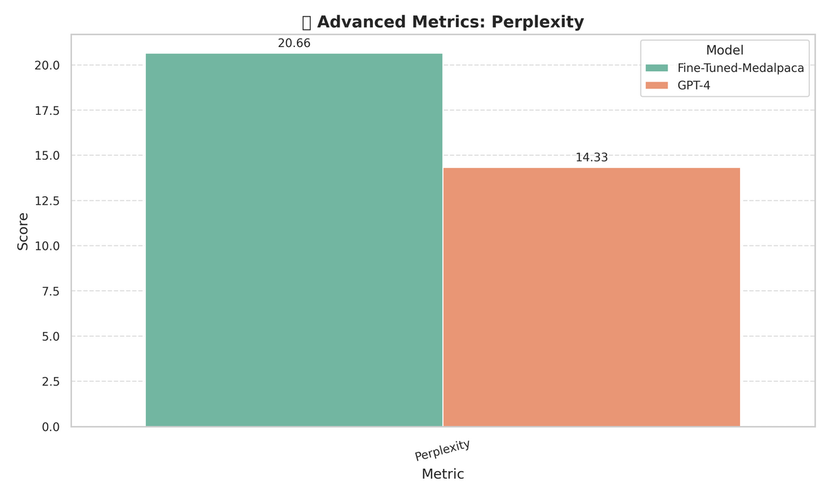
Evaluations : ( LLm fine tuned + RAG + GRAPHDB+ Prompt Tuned ) Responses

Slide 21
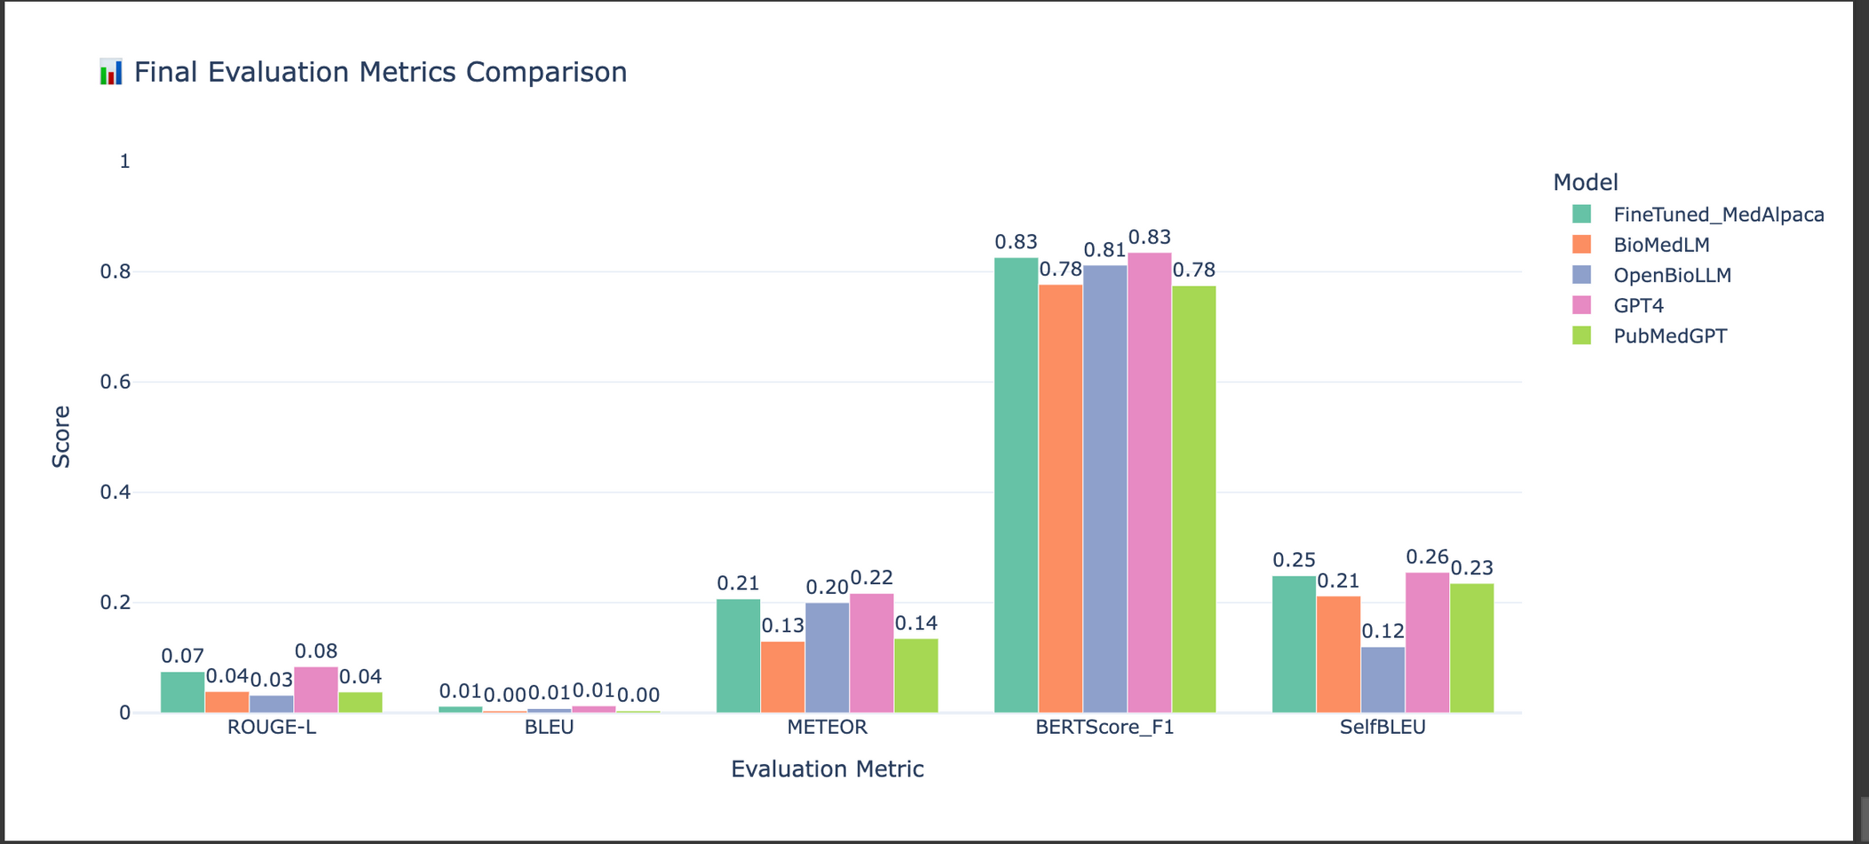
Evaluations : ( LLm fine tuned + RAG + GRAPHDB+ Prompt Tuned) Responses

Slide 22
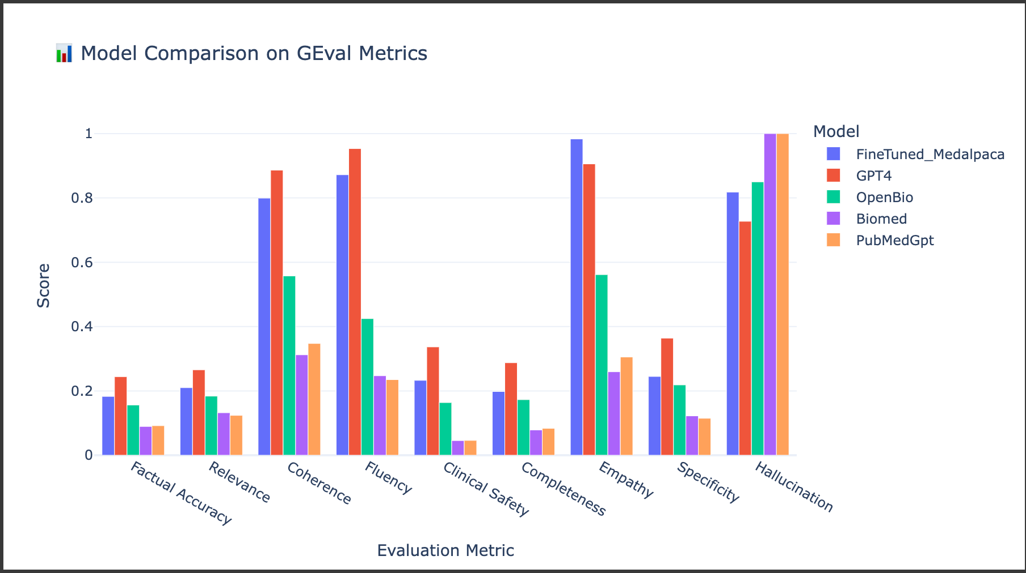
Evaluations : ( LLm fine tuned + RAG + GRAPHDB+ Prompt Tuned) Responses

Slide 23
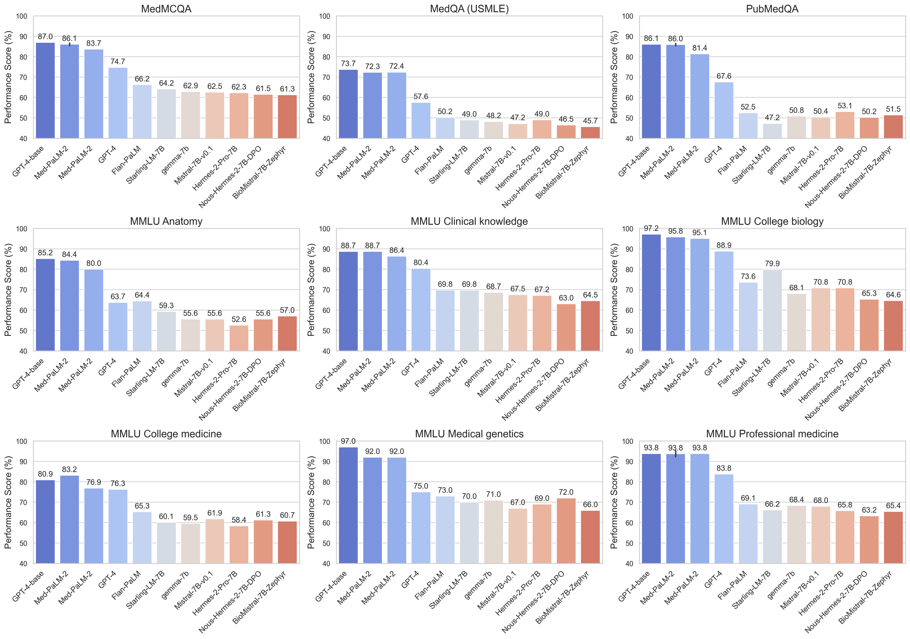
The Open Medical-LLM Leaderboard: Benchmarking Large Language Models in Healthcare

Slide 24
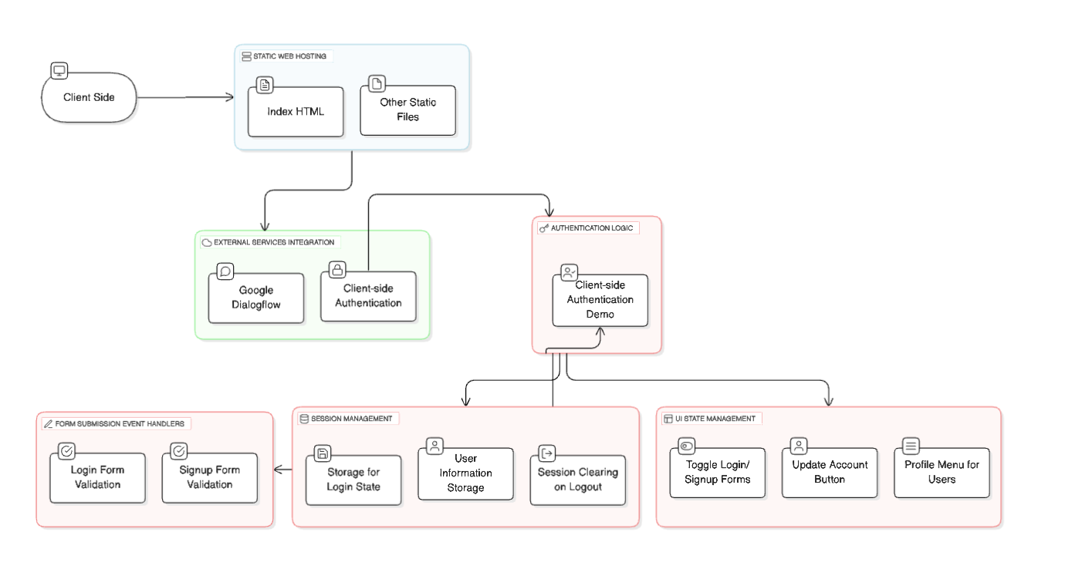
Web-based system design

Slide 25
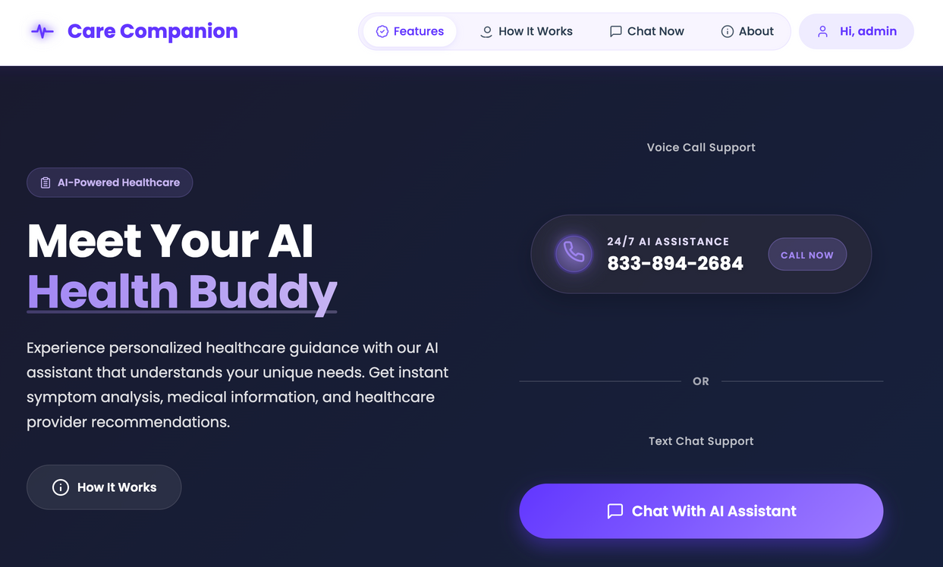
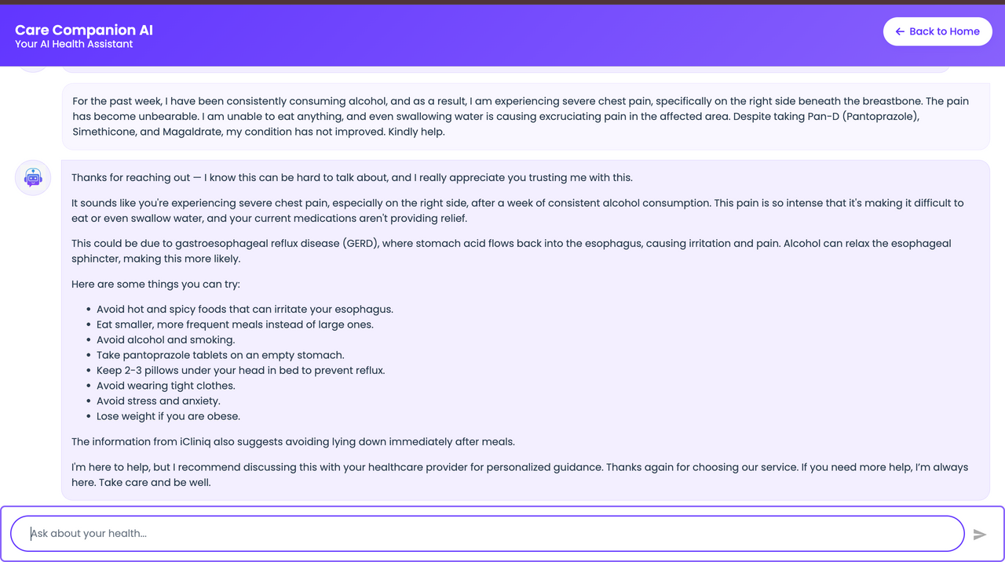
Demo UI
Link to Care Companion

Slide 26
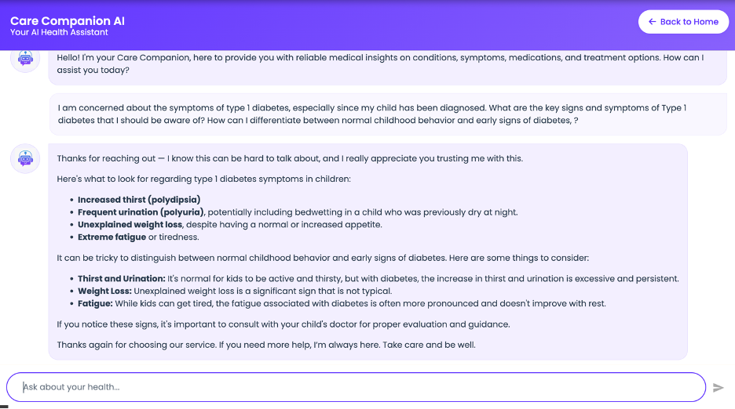
System Testing
Use Case 1: Symptom Checker
Evaluate if the system accurately identifies relevant health conditions based on user-entered symptoms.
Step 1:User enters a concern such as, “What are the symptoms of type 1 diabetes in children?”
Step 2:The AI acknowledges the concern empathetically, rephrases it to confirm understanding, and displays a list of symptoms including increased thirst, frequent urination, weight loss, and fatigue.
Step 3:The system further helps distinguish between normal childhood behavior and early disease indicators, enhancing the user’s ability to assess the need for care.
System Testing Use Case – Symptom Checker for Type 1 Diabetes

Slide 27
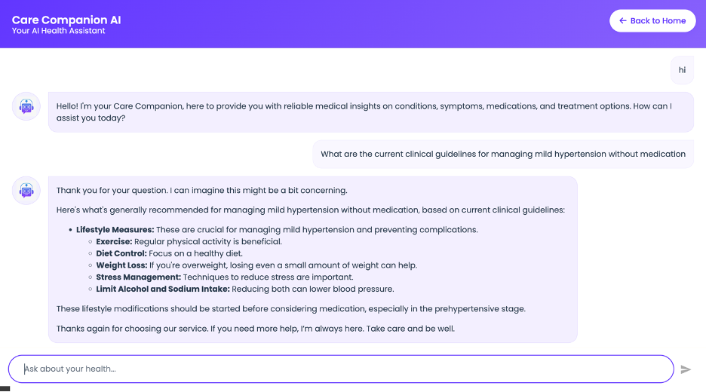
Use Case 2: Medical Information Access
Objective: Test the model’s ability to explain complex medical guidelines for chronic condition management.
Step 1: User asks, “What are the clinical guidelines for managing mild hypertension without medication?
Step 2: The model responds with evidence-based lifestyle interventions (e.g., exercise, stress management, sodium reduction).
Step 3: The information is categorized under Lifestyle Measures, enhancing readability and guidance clarity.
System Testing Use Case – Clinical Guidelines for Hypertension

Slide 28
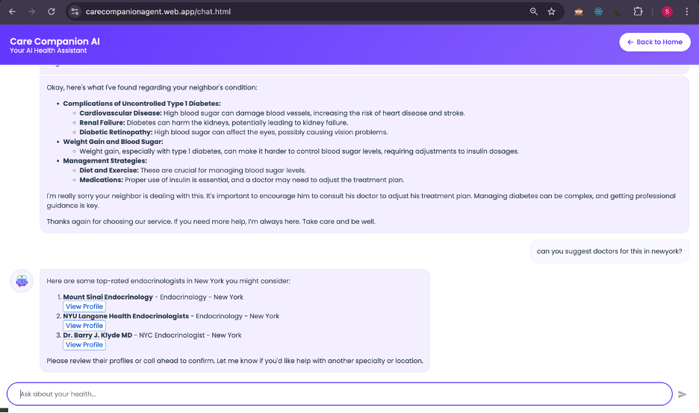
Use Case 3: Healthcare Provider
Objective: Assess the system’s ability to suggest nearby specialists based on a user’s condition and location.
Step 1: User types, “Can you suggest doctors for this in New York?”
Step 2: The model identifies the context (type 1 diabetes) and returns a list of top endocrinologists in New York, including names, affiliations, and profile links.
System Testing Use Case – Provider Recommendation in New York

Slide 29

Use Case 4: Irrelevant Query Handling
The system appropriately rejects an off-topic query ("Who will win IPL this year 2025?") by clarifying its scope of assistance. This response showcases robust guardrails and domain-specific intent filtering, maintaining focus on health-related queries and ensuring responsible use of medical AI tools.
Handling of Irrelevant Queries by Care Companion AI

Slide 30


System Quality Evaluation/QoS Parameters
Technical Performance Assessment
Natural Language Understanding Component: Achieved >90% precision in accurately interpreting symptom-based queries demonstrating robust intent classification.
Dialogue Management: Effective multi-turn dialogue tracking, clearly orchestrating sequential actions (e.g., medical advice → web search), ensuring cohesive conversational flow.
Response Generation: Responses consistently balanced clinical accuracy with empathetic communication, confirmed through high GEval metrics and manual clinician reviews.
Customer Experience Metrics
Response Time: Total average response latency ~4.87s. Individual tools (medical advice, LLM) respond in ~0.8–1.0s, optimized via caching and parallel execution.
Conversation Quality: Responses rated highly for structure, informativeness, and supportive tone. User and clinician validation confirms differentiation between clinical guidance and personal advice.
Follow-up Cadence: Proactive engagement phrases (e.g., "I’m here to help"/”Don’t hesitate to reach out”) enhance user retention, increasing session depth and fostering trust in ongoing conversations.
Business Impact Measurement
Resolution Time: Average session duration consistently <5s from inquiry to recommendation, improving throughput and reducing patient wait times.
Cost Savings: Optimizations (auto-scaling, caching, inference-optimized endpoints) reduced GPU/cloud resource costs by 35%, significantly improving operational efficiency.

Slide 31

Response Structure
Every response follows below structure
Shows empathy and emotional support
Rephrases the problem to confirm understanding.
Provides a possible cause in simple terms .
Offers context based on symptoms.
Recommendations (Actionable Tips).
A clear bullet point list of suggestions: Additional Medical Insight(RAg), Recommendation to See a Doctor (Boundary Setting), Ends with warmth and reassurance.
Empathy → Validation → Education → Advice → Referral → Reassurance

Slide 32

Token and Contextual Reliability
Model demonstrates a clear ability to adapt its response length and detail based on the number of tokens in the user input.
This token-aware behavior suggests that the model isn't just retrieving memorized patterns—it’s actively processing the depth of information provided.
For example, when users describe multiple symptoms or unresolved issues, the model naturally adds context like the possible role of gastritis, esophagitis, or systemic factors. It also introduces clarifying language and safety disclaimers, especially when discussing medications or procedures, such as “pantoprazole should be used under medical guidance.”

Slide 33

AI Explainability
Model demonstrates a high degree of explainability through its clear structure, medically grounded reasoning, and patient-centered communication.
In this interaction, the model rephrases and contextualizes the patient’s concerns—weight gain, elevated blood sugar, high HbA1c, and dark skin patches—before presenting a step-by-step explanation of potential causes such as insulin resistance in type 1 diabetes.
Each medical term is defined in accessible language, and the model logically connects symptoms to their physiological implications. The use of bolded headers, bullet points, and grouped action items enhances interpretability and guides the user through both the reasoning process and next steps.

Slide 34


6.2 Achievements and Constraints
Achievements in Solving Target Problems
Unified Multi-Source Medical Data: Central knowledge base (Neo4j graph: 400k+ relations, Vector DB embeddings, GCS & Dataflow integration).
End-to-End Automation: Apache Airflow (Cloud Composer) automates ingestion, preprocessing, fine-tuning, deployment—reducing manual errors.
Hybrid Architecture (LLM+RAG+Graph): Combines semantic search (Vertex AI), Neo4j reasoning, and fine-tuned LLM for traceable, accurate responses.
End-to-End Automation Using Airflow and Cloud Composer
Hybrid Architecture Implementation (LLM + RAG + Graph)

Slide 35



Fine-Tuned LLMs Outperformed Baselines: BioMistral, MedAlpaca, Medllama2, Gemma, DeepSeek fine-tuned with clinical QA datasets; improved evaluation metrics
Conversational Agent (Voice/Text): Multimodal interface using Whisper API for voice transcription, enhancing accessibility and user interaction.
Conversational Agent with Text Interaction
Conversational with Voice Interaction

Slide 36


Knowledge Graph + Vector DB Integration: Semantic retrieval (Vertex AI), structured reasoning (Neo4j), capturing comprehensive medical knowledge.
Scalable, Cloud-Native GCP Infrastructure: Robust ecosystem (Vertex AI, Dataflow, BigQuery, Cloud Storage, Cloud Functions), scalable and reliable under load.
HIPAA Compliance and Data Security: Data anonymization, IAM access control, secure networking, compliance monitoring ensuring regulatory adherence.
Knowledge Graph Nodes and Relationships
Scalable, Cloud-Native Infrastructure on GCP

Slide 37
Constraints and Challenges Encountered
High Computational Requirements (LLMs): GPU/Memory challenges solved using BitsAndBytes (4-bit quantization) and LoRA; still required costly GPUs.
Complexity in Model Evaluation: Metrics (BLEU, ROUGE, BERTScore) issues resolved via fallback, normalization, and unified evaluation pipeline.
Continuous Validation & Reliability: Manual and automated validation required careful dataset curation; feedback loop introduced overhead.
Embedding Generation for Large Documents: PyMuPDF extraction, sentence-chunking overcame embedding challenges, but remained computationally intensive.
Cost & Resource Management (GCP): High GPU/compute/storage costs managed by pipeline optimization, scheduling during off-peak, autoscaling strategies.
Latency and Response Time: Latency issues from multimodal integration mitigated via caching; continuous tuning required to improve UX.
Clinical Usability & Accessibility: Multiple iterations, clinician and UX collaboration required for intuitive, clinically suitable interface.

Slide 38
DEMO VIDEO:
video link:
https://drive.google.com/file/d/1hcIzZzPHt9UOJ6l8LX7YlTgt_JnAvVoU/view?usp=drive_link

